Slide 1

Schizophrenia
By: Tina Hoff
NUR 869: Special Populations

Slide 2

Objectives
Patient Case
History
Examination & Diagnostics
Pathophysiology
Management Plan

Slide 3

Intro to Patient Case:
K.A. is a 29-year-old female
Reason for Visit: Medication Management
  “I’m doing well, I caught myself in a distraction but recognized it and came out it.”
Mental health disorders: Schizophrenia, ADHD, anxiety, depression, and bipolar.
History:
  Dx: 24 yo
  In Japan
  Symptoms: Hallucinations, delusions, fixations, withdrawn, disorganized.
Notes:
She is stable, with incredible self-awareness to behaviors, fixations, and mood.

Slide 4
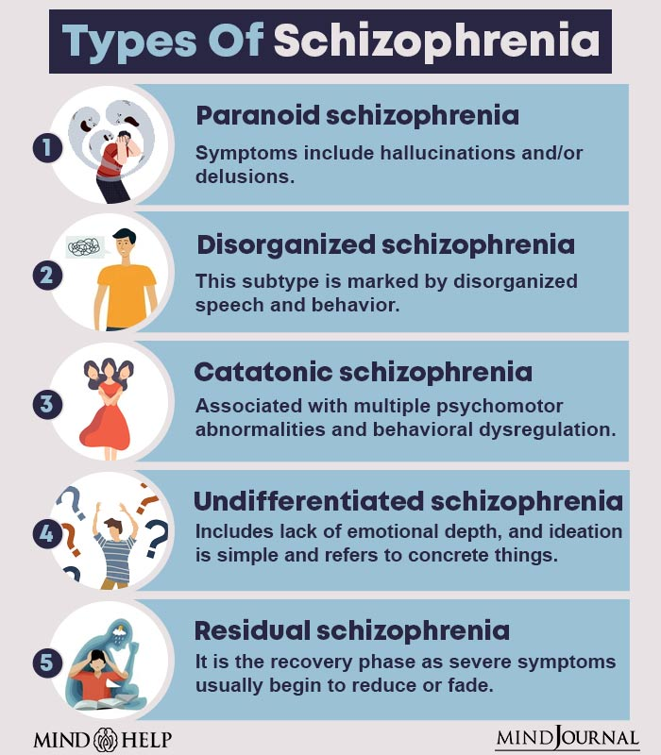
What is Schizophrenia?
Disabling psychiatric condition
Affects 1% worldwide
Top 10 global disability causes
Psychotic symptoms
Affecting executive function, memory, & mental processing speed.
(Classification of Schizophrenia, n.d.; Fischer & Buchanan, 2025; Hany & Rizvi, 2024)
Notes:
Schizophrenia is a disabling psychiatric condition impacting around 1% of people worldwide and ranking among the top 10 global disability causes.
Schizophrenia is characterized by positive psychotic symptoms such as hallucinations, delusions, disorganized speech, and disorganized or catatonic behavior; negative symptoms such as reduced motivation and expressiveness; and cognitive impairments affecting executive function, memory, and mental processing speed.
Negative symptoms: are conceptualized as an absence or diminution of normal processes. Usually one of the first manifestations of schizophrenia; up to 70 percent of patients experience negative symptoms prior to their first positive symptom.
Positive symptoms: includes the reality distortion symptoms of hallucinations and delusions, as well as disorganized thoughts and behavior
The effect of schizophrenia on daily life varies greatly, with many individuals facing significant disability and incomplete recovery.

Slide 5
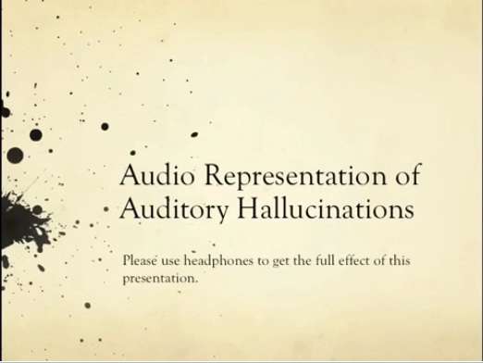

Slide 6
What is Common?
Mnemonic - SHADED
Speech Poverty
Hallucinations
Avolition
Delusions
Emotional Flattening
Disorganized/Catatonic behavior
Mood and anxiety symptoms
Lack awareness
  Stigma & Self-stigma
Physical Symptoms:
  Neurologic disturbances, Catatonia, Sleep disturbances, and Metabolic disturbances
Co-occurring medical conditions
(Fischer & Buchanan, 2025; Hany & Rizvi, 2024)
Notes:
Mood and anxiety symptoms are common in schizophrenia; mood and anxiety disorders appear to occur at a higher rate than in the general population.
Demonstrate a lack of awareness of their illness. This can result in difficulties forming a therapeutic alliance with clinicians and in adhering to prescribed treatment.
In the course of assessment and ongoing clinical care, we are an important source of compassion and education for the patient and family. Along with treatment for symptoms and medication side effects, the patient may need help coping with disabilities, associated losses, and the stigma associated with the diagnosis of schizophrenia. The experience of stigmatizing attitudes towards people with schizophrenia is common and may be internalized, leading to "self-stigma". Internalized stigma can be as damaging as the direct effects of the illness.
At increased risk of developing several co-occurring medical conditions. In other studies, schizophrenia has been prominently associated with greater rates of cardiovascular disease, dyslipidemia, dementia, and type 2 diabetes compared with the general population, with a resulting decrease in average lifespan of up to 20 years

Slide 7
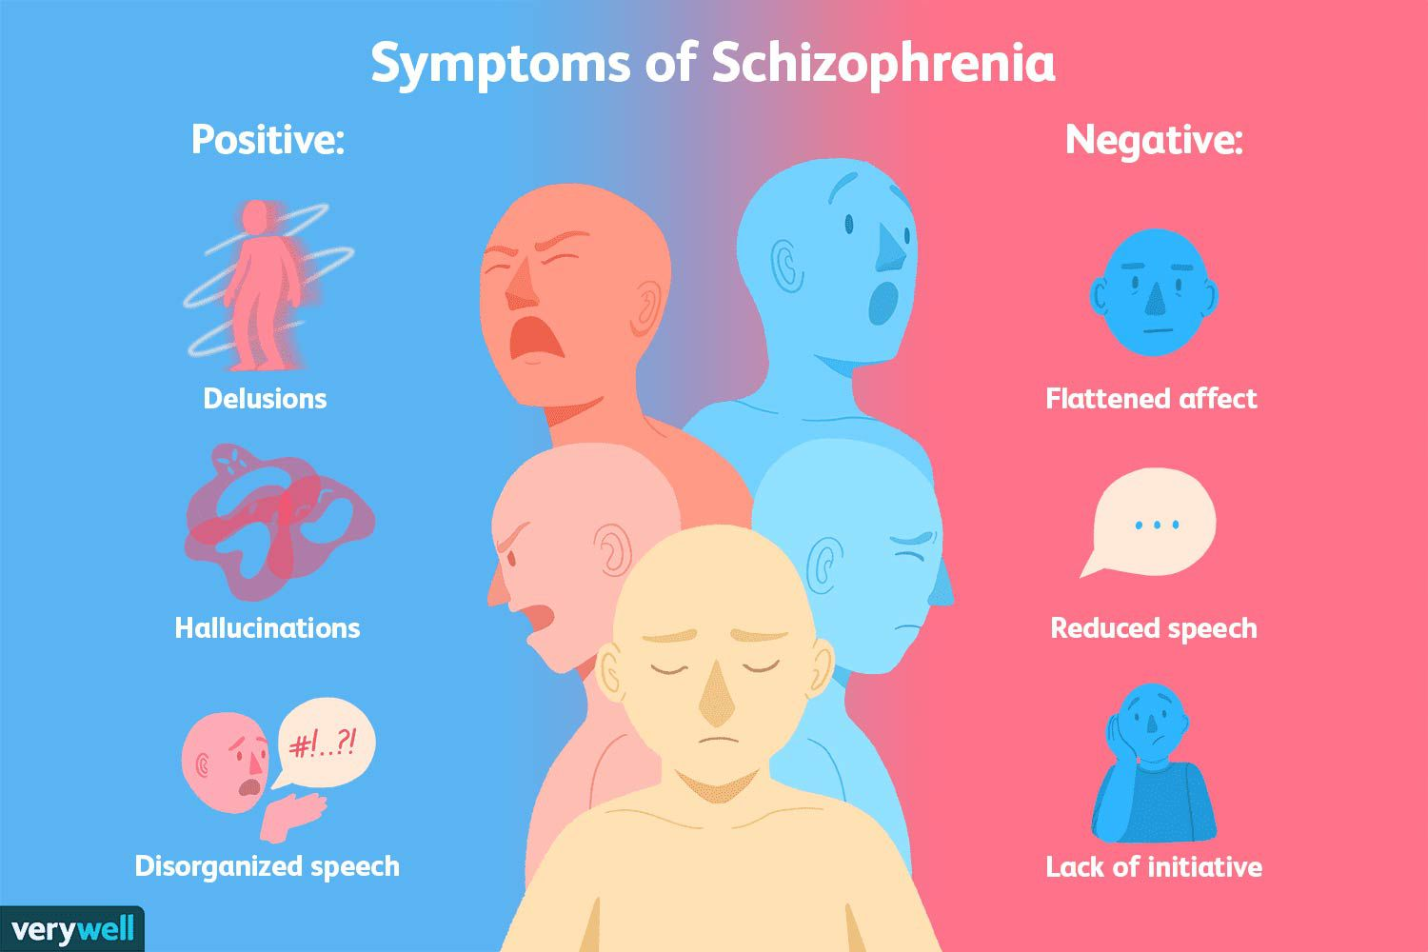
Diagnosis
Early Recognition & Intervention
Presentation:
  Onset – Abrupt vs insidious
  Symptom presentation – Continuous vs intermittent
  Outcome – Poor vs nonpoor
Timing: Late adolescence, early adulthood
Factors - Genetic, environmental, & neurobiological
Men more at risk than women
(Fischer & Buchanan, 2025; Hany & Rizvi, 2024)
Notes:
The clinical diagnosis of schizophrenia is made after obtaining a detailed psychiatric history and mental status examination and after ruling out other psychiatric and medical causes of psychosis. Risk factors include birthing complications, the season of birth, severe maternal malnutrition, maternal influenza during pregnancy, family history, childhood trauma, social isolation, cannabis use, minority ethnicity, and urbanization.
Onset – Abrupt versus insidious
Symptom presentation – Continuous versus intermittent
Outcome – Poor versus nonpoor
Most have acute onset, intermittent symptoms, and later had no or only mild symptoms.
Timing: Late adolescence, early adulthood
Factors - Genetic, environmental, & neurobiological
Genetic
chromosome 22q11.2 deletion, which increases lifetime risk 25-fold.
Substance Use: For example: Use of cannabis is known to induce temporary psychotic effects. THC may exacerbate preexisting psychotic conditions and is a risk factor for schizophrenia. Studies indicate a heightened schizophrenia risk among young cannabis users and heavy cannabis users, with the risk seeming dose-dependent and more pronounced in those who begin using at an earlier age or consume more potent strains. In one study, heavy cannabis users were at 6 times greater risk than nonusers of receiving a diagnosis of schizophrenia.
Brain: exhibit both structural and functional brain abnormalities. Lateral ventricle enlargement by about 25%, coupled with an approximate 2% reduction in overall brain volume, primarily in the grey matter, is seen in schizophrenia. This decrease in grey matter is noted predominantly in the frontal and temporal lobes and the hippocampus. There is evidence of reduced activity in the dorsolateral prefrontal cortex both at rest and during executive tasks, along with increased activity in the medial frontal cortex.
Men typically exhibit an earlier onset of the disease, poorer functioning before the illness becomes apparent, more pronounced negative symptoms, and a higher incidence of alcohol and substance use disorders.

Slide 8
DSM-5 Criteria:
A. Two or more of the characteristic symptoms below are present for a significant portion of time during a one-month period (or less if successfully treated):
Delusions
Hallucinations
Disorganized speech (eg, frequent derailment or incoherence)
Grossly disorganized or catatonic behavior
Negative symptoms (ie, affective flattening, alogia, or avolition)
(American Psychiatric Association, 2013)
Notes:
Schizophrenia lasts for at least 6 months and includes at least 1 month of active-phase symptoms.

Slide 9
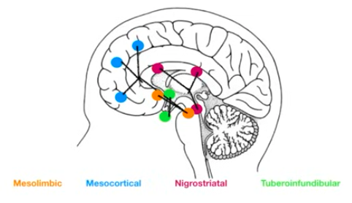
Pathophysiology
(Dirty Medicine, 2019; Fischer & Buchanan, 2025; Hany & Rizvi, 2024; Rogers, 2023)
Notes:
No model completely explains schizophrenia.
Neurotransmitter abnormalities with dopamine, serotonin, glutamate, and gamma-aminobutyric acid (GABA) all playing roles.
Four key dopamine pathways have been identified in the brain: mesolimbic, mesocortical, tuberoinfundibular, and nigrostriatal.

Slide 10
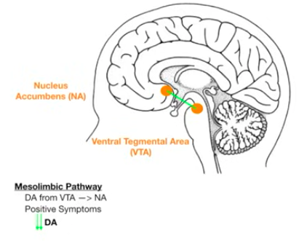
Mesolimbic Pathway
(Dirty Medicine, 2019; Fischer & Buchanan, 2025; Hany & Rizvi, 2024; Rogers, 2023)
Notes:
Excessive dopamine activity or overactive in the mesolimbic pathway, which runs from the ventral tegmental area to the limbic regions, is thought to contribute to the positive symptoms of schizophrenia.
The VTA is Vere the Trouble Arises.
Antipsychotic medications decrease the dopamine activity.

Slide 11
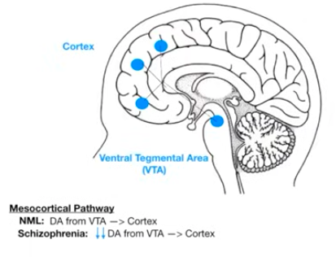
Mesocortical Pathway
(Dirty Medicine, 2019; Fischer & Buchanan, 2025; Hany & Rizvi, 2024; Rogers, 2023)
Notes:
In Schizophrenia there is reduced dopamine levels in the mesocortical pathway, connecting the ventral tegmental area to the cortex, may increase the negative symptoms and cognitive deficits.

Slide 12
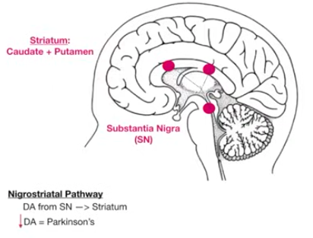
Nigrostriatal Pathway
(Dirty Medicine, 2019; Fischer & Buchanan, 2025; Hany & Rizvi, 2024; Rogers, 2023)
Notes:
Nigrostriatal pathway is linked to the coordination of movement and the extrapyramidal motor side effects caused by D₂ receptor blockers. This pathway is important because the antipsychotics used to treat schizophrenia affect this part of the brain and can cause medicine induced Parkinsonism.

Slide 13
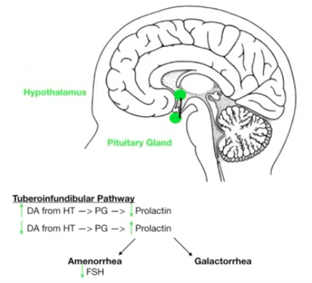
Tuberoinfundibular Pathway
(Dirty Medicine, 2019; Fischer & Buchanan, 2025; Hany & Rizvi, 2024; Rogers, 2023)
Notes:
Tuberoinfundibular pathway is associated with the hyperprolactinemia observed with D₂ receptor blocker use. This pathway is important because the antipsychotics used to treat schizophrenia affect this part of the brain and can cause increased levels of prolactin leading to amenorrhea (decreased FSH) and galactorrhea.

Slide 14
Antipsychotics DECREASE dopamine
Improve Positive Sxs
Worsen Negative Sxs
Risk Galactorrhea & Amenorrhea
Risk EPS
(Dirty Medicine, 2019; Fischer & Buchanan, 2025; Hany & Rizvi, 2024; Rogers, 2023)
Notes:
Neurotransmitter abnormalities with dopamine, serotonin, glutamate, and gamma-aminobutyric acid (GABA) all playing roles.
Four key dopamine pathways have been identified in the brain: mesolimbic, mesocortical, tuberoinfundibular, and nigrostriatal.

Slide 15
Deep Dive into Patient Case:
K.A. is a 29-year-old female
Reason for Visit: Medication Management
  “I’m doing well, I caught myself in a distraction but recognized it and came out it.”
HPI:
  Feels better with low dose stimulant
  Last 4 days had irresponsible fixations
  Life looks like she would be sad but she doesn’t feel sad
  No hallucinations, no delusions.
  Taking medications as prescribed, no side effects.
Notes:
Mental health disorders: Schizophrenia, ADHD, anxiety, depression, and bipolar.
Previous visit was 2 weeks ago: Recently has been feeling "really good, inspired" and starting to question the need for a mood stabilizing medication. She has been working on a more balanced diet and has been having more energy. Has seen slight weight gain and feeling tired so feels she is trying to "figured it out." With the Latuda she has noticed that she is having more dreams but it doesn't disrupt her sleep. Waking up is a little more difficult. She has tailored her day to still get things down in the AM vs PM. WORK: She is doing well at her new job but gets frustrated with herself that she doesn't know everything yet. She note that she lacks motivation to maintain and get good at it. These feelings vary day to day. OVERALL: No hallucinations or delusions. Recognizing impulsivity and taking steps to take time to think about the thoughts. ADHD has moderate improvement with coffee (1 cup in the AM and in the afternoon) for about 10 minutes. Education provided about dopamine with stimulants. Improved with diet around the house, but work is slowly using its luster. Anxiety: has been good.
Recommendations: try a low dose stimulant (Ritalin) to see if that helps with the ADHD symptoms, continue all other medications as prescribed. Follow up in 2 weeks.
Fast forward to current day: She feels better with the added low dose stimulant. When distracted she can go back to what she was doing. Motivation is better and feels like she has the power to get things done. By 3-4pm she is back to not being able to focus. Mood - the last 4 days she feels like she is having irresponsible fixations, life looks like she would be sad but she doesn't feel sad, no hallucinations, no drastic up/downs, sleeping way too much (new since the stimulant), had a low for a couple days. No side effects of the medication.

Slide 16
Case History
Allergies: No known allergies to medications, environmental, or latex.
Medications:
  Latuda 60mg Evening
  Methylphenidate 5mg BID
  Multi-vitamin daily
  Magnesium glycinate at bedtime
  GABA supplement daily
Medical History:
  Schizophrenia, ADHD, anxiety, depression, and bipolar
Social: Works part-time as a care associate and part-time as a bank teller.
Living situation: Lives alone in apartment.
Sexually Active: Yes, condoms for pregnancy prevention
Pertinent Family History:
  Mom: Alive. Anxiety, Depression
  Dad: Alive. Hypertension, Hyperlipidemia, Bipolar
  Maternal Grandmother: Alive. Hypertension, Anxiety, Depression
  Paternal Grandfather: Alive. Bipolar
Immunizations: Up-To-Date
Tobacco/Vaping/Alcohol/2nd hand smoke/Drugs: No
LMP: 9/23/25
Surgical History: Wisdom extraction - 2012

Slide 17
ROS & Physical Exam
Vitals: 124/88; P: 88; Wt: 165lbs
General: Alert, relaxed, cooperative, well-groomed appearance with good personal hygiene. Moves and lies flat without discomfort.
Neurologic: Alert, relaxed, and cooperative. Thought process coherent. Orientated to person, place, and time.
Musculoskeletal: Walking: smooth, coordinated pattern with steady movement, and appropriate arm swing. Able to sit and return to standing without evidence of flaccidity or spasticity.
Psychiatric: Full and congruent affect, euthymic. Alert, relaxed, and cooperative. Able to articulate well with fluent speech/language rate, volume, coherence. No evidence of hallucinations, delusions, or obsessions, thought process coherent, demonstrates appropriate judgment and insight, displays ability to recall recent and remote events and fund of knowledge is intact. Attention span and ability to concentrate is appropriate. Orientated to person, place, and time.
General: Denies unintentional weight gain or loss, fever, chills, night sweats, loss of appetite, diaphoresis, or fatigue.
Cardiovascular: Denies chest pain, heart palpitations, or lower extremity edema.
GI: Denies abdominal distention, abdominal pain, constipation, diarrhea, nausea, or vomiting.
Endocrine: Denies heat intolerance, cold intolerance, excessive sweating.
Neurologic: Denies headaches, lightheadedness, dizziness, weakness, numbness, tingling, fainting, speech difficulty, or seizures.
Psychiatric: Denies agitation, anger, panic attacks, nervousness/anxiety, behavior problems, confusion, hallucinations, hyperactivity, self-injury, sleep disturbance, or suicidal ideations.

Slide 18

Management Plan
Assess the whole person
Treat co-occurring diseases/disorders
Multidisciplinary care: Integrate blend of function, life-satisfactions, and independence
Pharmacotherapy
  Monitor for side effects
Psychosocial intervention
(Bustillo, 2025; Stroup & Marder, 2025)
Notes:
Goal: Remission and recovery — Remission of schizophrenia refers to a state in which the individual has no symptoms, or minimal symptoms which do not interfere with behavior, for a period of at least six months. The consumer-driven model is a blend of function, life-satisfaction, and independence. As chronic or recurrent psychosis is commonly associated with impairments in social and occupational functioning.
Higher risk of suicide: the rate of suicide was found to be over four times higher than the general population with the highest age group being 18 to 34 years.
Multidisciplinary care: Integrate blend of function, life-satisfactions, and independence
individualized treatment plans including pharmacotherapy, case management, family intervention, and other community outreach services.
Pharmacotherapy: Antipsychotic medications are the first-line medication treatment
Glucose abnormalities, Prolactin elevation, QTc prolongation, hyperlipidemia
Weight gain, sedation, anticholinergic, Orthostatic hypotension
Tardive dyskinesia, dystonia, parkinsonism, Akathisia
Duration of antipsychotic therapy — For patients with known or suspected schizophrenia who have recovered from an acute first psychotic episode, we recommend continuing antipsychotics for at least two to three years. It might be reasonable to discontinue this medication.
Psychosocial intervention as an adjunctive to pharmacologic management
Psychosocial interventions aimed at education and engagement of the patient and their family (or other supports), improving social skills, and offering cognitive remediation may improve overall psychosocial functioning and quality of life.
Early intervention program – These are multimodal programs offering a combination of patient and family psychoeducation, social skills training, cognitive-behavioral therapy (CBT), and community outreach (eg, home visits).
Family psychoeducation intervention.
Cognitive remediation.
Social skills training.
CBT for psychosis (CBTp).
Motivational interviewing with CBTp.

Slide 19
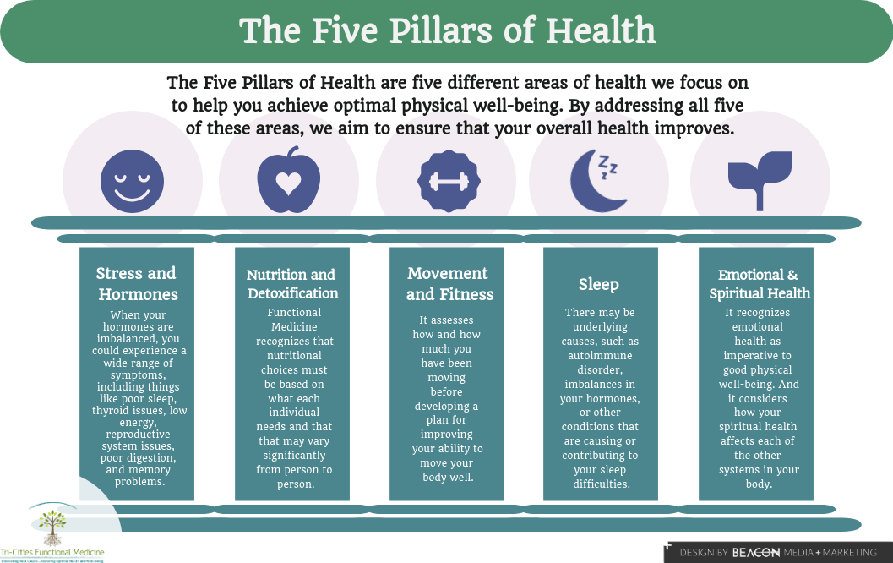
Case Management Plan
Medications & Supplements:
  Latuda 60mg Evening
  Methylphenidate 10mg XR in the AM
  Methylphenidate 5mg IR in the afternoon
  Multi-vitamin daily
  Magnesium glycinate at bedtime
  GABA supplement daily
Exercise: 150 minutes of moderate-intensity physical activity a week along with 2 days of muscle-strengthening activity each week.
5 Pillars of Health
(Tri-Cities Functional Medicine, 2022)
Notes:
Recommendations: Continue to monitor mood and fixations. Feel we could switch to an extended release making the ups and downs as drastic. Education on when to take it within the day. Follow-Up: 4 weeks or sooner if necessary.

Slide 20
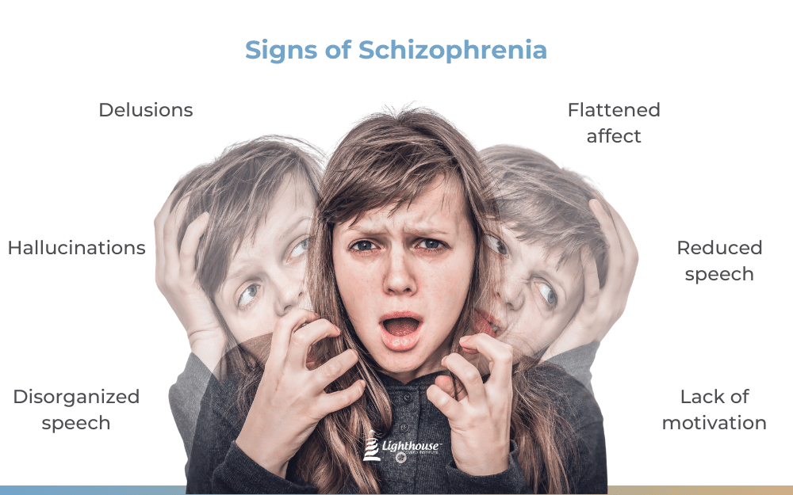
Recap
Disabling condition
Neurotransmitter abnormalities
4 Key Dopamine Pathways
Remission Goal
Treatment: 1st line is Antipsychotics
Multidisciplinary approach
Notes:
Schizophrenia is a disabling psychiatric characterized by positive psychotic symptoms such as hallucinations, delusions, disorganized speech, and disorganized or catatonic behavior; negative symptoms such as reduced motivation and expressiveness; and cognitive impairments affecting executive function, memory, and mental processing speed.
Timing: Late adolescence, early adulthood
Neurotransmitter abnormalities with dopamine, serotonin, glutamate, and gamma-aminobutyric acid (GABA) all playing roles.
Four key dopamine pathways have been identified in the brain: mesolimbic, mesocortical, tuberoinfundibular, and nigrostriatal.
Treatment:
Goal: Remission and recovery — Remission of schizophrenia refers to a state in which the individual has no symptoms, or minimal symptoms which do not interfere with behavior, for a period of at least six months.
Multidisciplinary care: Integrate blend of function, life-satisfactions, and independence
individualized treatment plans including pharmacotherapy, case management, family intervention, and other community outreach services.
Antipsychotic medications are the first-line medication treatment
Glucose abnormalities, Prolactin elevation, QTc prolongation, hyperlipidemia
Weight gain, sedation, anticholinergic, Orthostatic hypotension
Tardive dyskinesia, dystonia, parkinsonism, Akathisia

Slide 21
References:
American Psychiatric Association. (2013). Diagnostic and statistical manual of mental disorders (5th ed.). American Psychiatric Publishing.
Bustillo, J. (2025). Schizophrenia in adults: Psychosocial management. UpToDate. Retrieved November 23, 2025 from https://www-uptodate-com.ezproxy.umary.edu/contents/schizophrenia-in-adults-psychosocial-management?search=schizophrenia&source=search_result&selectedTitle=8~150&usage_type=default&display_rank=8
Classification of Schizophrenia. (n.d.). CGS Psychology Blog: Mrs Harris [Blog]. https://mrsharrispsychology.school.blog/classification-of-schizophrenia/
Dirty Medicine. (2019). Dopamine pathways. YouTube.com. https://www.youtube.com/watch?v=wCtC3LN2Vfc
Fischer, B. A., & Buchanan, R. W. (2025). Schizophrenia in adults: Clinical features, assessment, and diagnosis. UpToDate. Retrieved November 23, 2025 from https://www-uptodate-com.ezproxy.umary.edu/contents/schizophrenia-in-adults-clinical-features-assessment-and-diagnosis?search=schizophrenia&source=search_result&selectedTitle=1~150&usage_type=default&display_rank=1
Hany, M., & Rizvi, A. (2024, February). Schizophrenia. National Library of Medicine: StatPearls [Internet]. https://www.ncbi.nlm.nih.gov/books/NBK539864/
Rogers, J. L. (2023). McCance & Huether’s pathophysiology: The biologic basis for disease in adults and children (9th ed). Elsevier.
Stroup, T. S., & Marder, S. (2025). Schizophrenia in adults: Maintenance therapy and side effect management. UpToDate. Retrieved November 23, 2025 from https://www-uptodate-com.ezproxy.umary.edu/contents/schizophrenia-in-adults-maintenance-therapy-and-side-effect-management?search=schizophrenia&source=search_result&selectedTitle=2~150&usage_type=default&display_rank=2
Tri-Cities Functional Medicine. (2022, March 4). The five pillars of health: The cornerstone of functional medicine. https://tcfxmed.com/the-five-pillars-of-health-the-cornerstone-of-functional-medicine/

Slide 22

Thank you!

