Slide 1
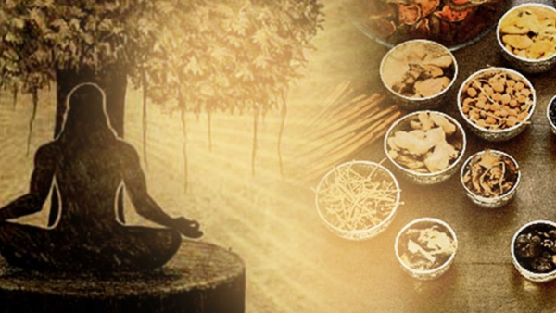
Ayurveda
Submitted by Christina Hoff
Nur 510: Healthcare Across the Population
Dr. Joan Doerner
October 6, 2022
This Photo by Unknown Author is licensed under CC BY

Slide 2


Ayurveda is a system of healing that deals with the nature, scope and purpose of life. It includes the metaphysical and physical aspects that influence the connection of mind, body, and spirit (Lad, 2002).
“Ayurveda embraces all health care disciplines and weaves them into an integrated treatment plan for each individual” (Lad, 2002, p. 2).
Ayurveda means “science of life” (Lad, 2002)
This Photo by Unknown Author is licensed under CC BY-SA
Lord Dhanvantari: God of Medicine

Slide 3
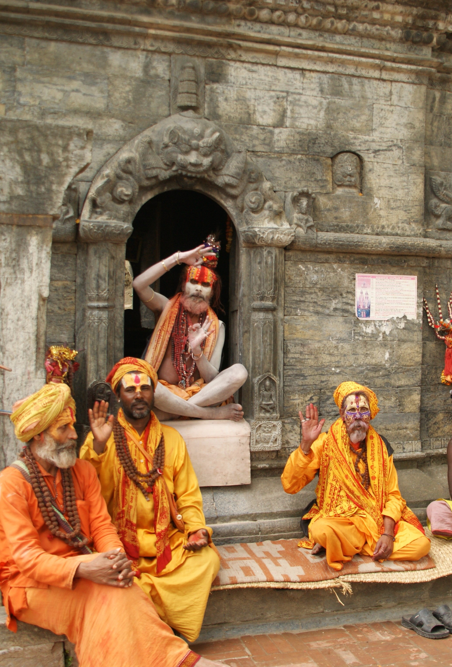
History
Complex healing systems with roots in Ancient India.
Thought to be the oldest healing system on the planet.
  Documented in ancient scripture – Vedas.
    More than 10,000 years old
Highly spiritual wisdom and pure knowledge revealed through the hearts of seers during meditation.
Began as an oral tradition and based on philosophy of Shad Darshan, The Six Philosophies of life.
  Sankhya: Truth of life
  Nyaya and Vaisheshika: Knowledge through observation and critical logic
  Mimamsa: Analyze and thoroughly understand the truth
  Yoga: The union of man with God
  Vedanta: Ending of knowledge

Slide 4
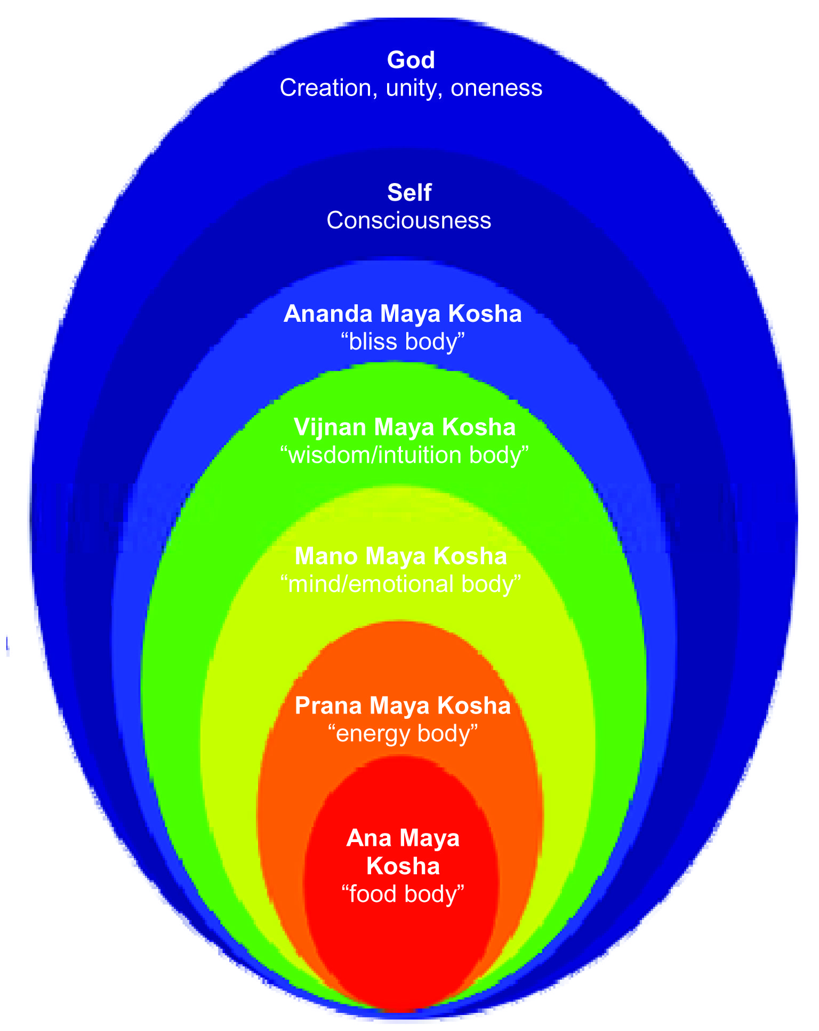

Concepts:
Prevent disease and illness by maintaining balance throughout the physical and energic bodies (koshas) (Lad, 2002).
Used alone and/or complementary to Western medicine.
Views each person as unique.
Great for primary care settings (Alisha et al., 2019).

Slide 5
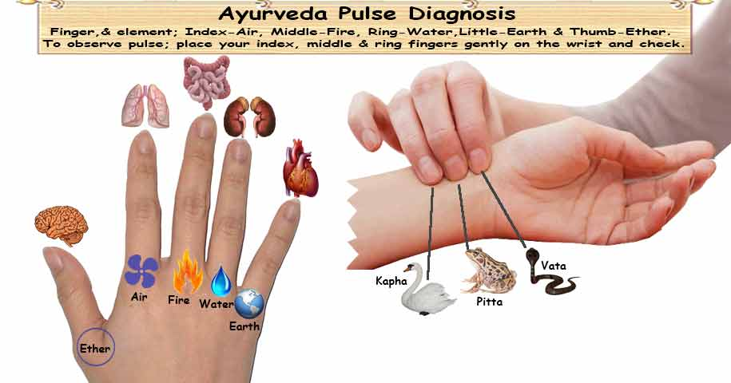
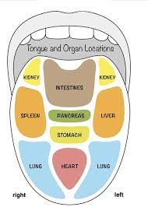
Diagnosis Components: Physical Exam
Based on 5 Elements that support life and maintain harmony:
  Earth, water, fire, air, ether
Each person is looked at as unique to their constitution (elemental make up):
  Prakriti: Original state (born as)
  Vikriti: Imbalanced state
Doshas: an interplay of elemental energy and applies to all concepts of life and movement:
  Kapha, Pitta, Vata
Pulse Reading
Tongue Reading
(Alisha et al., 2019; Lad, 2002)

Slide 6
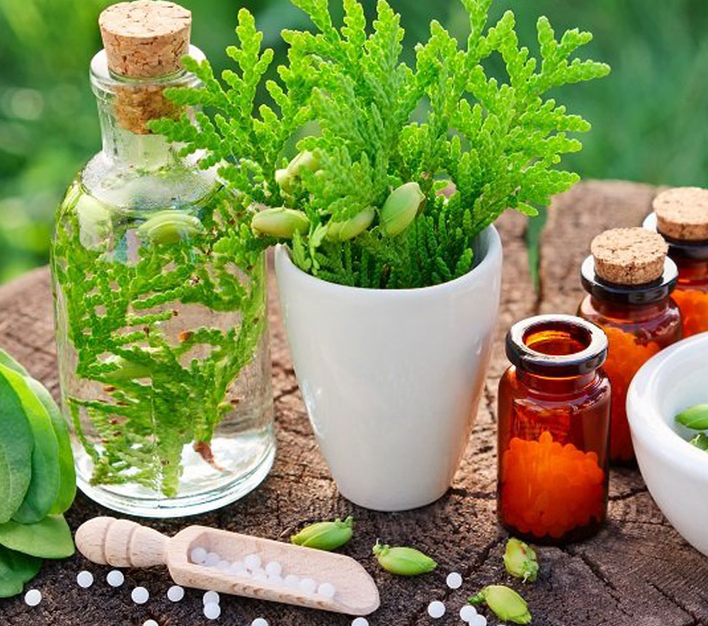

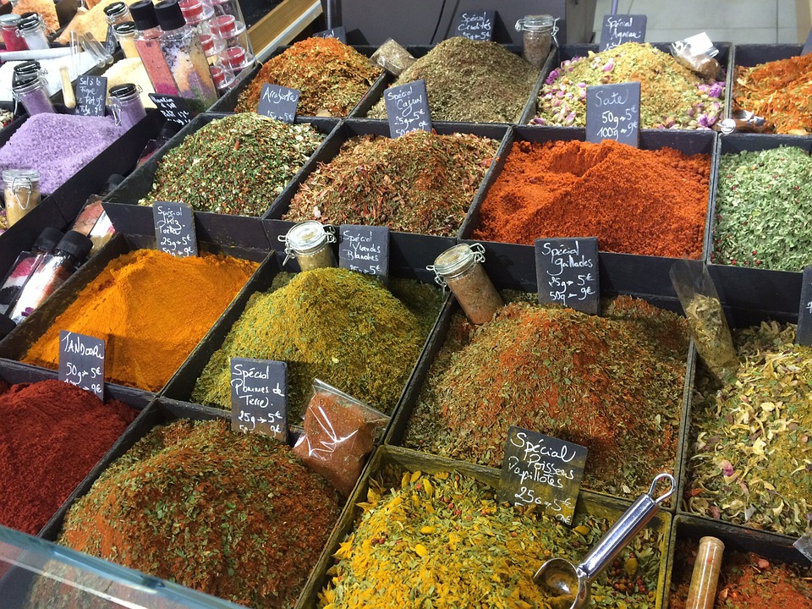
Treatments Components:
Aims to balance the vayus, or airs, of the body to create balance.
  Herbal Medicines
  Diet
    Foods and spices
  Cleansing Practices (panchakarama)
    Lifestyle based (dinacharya)
    Yoga asana (movement)
    Spiritual practices (meditation)
(Alisha et al., 2019; Lad, 2002)
This Photo by Unknown Author is licensed under CC BY-SA

Slide 7
Public Health Implications:
Direct Impact on Healthcare
Positive
Ayurveda utilizes nature to promote health and wellness.
  Malnutrition affects 22% of children and is a factor in about ½ of all child deaths:
    Milk is scarce; children receive Ashwagandhadi Choornam, an ayurvedic nutritional and iron supplement with excellent results reducing signs of malnutrition and boosting immunity.
  Anemia and related complications account for 40% of maternal deaths:
    Bhasma, Arishta, and medicated ghee have aided in the reduction of complications and deaths.
  Acute Respiratory Infections (ARI)
    Ayurveda treatments decrease morbidity and mortality related to viral or bacterial respiratory illnesses.
(Mukundan & Girija 2022)
Negative
Ayurvedic medications not regulated during manufacturing.
  Adulterated or inherent constituents like alkaloids or steroidal properties may impact the body negatively (Paudyal et al. 2019).
  Reports of toxic metals lead to poisoning cluster:
    252 Ayurvedic medicine samples:
      Lead found in 65%
      Mercury found in 38%
      Arsenic found in 32%
(Mikulski et al., 2017)
Limited practitioners based on limited opportunity and quality education (Alishia et al., 2019).

Slide 8
Public Health Implications:
Indirect Impact on Healthcare
Positive:
  Ayurveda gives emphasis to personal health & community health.
  Feelings of following tradition and holistic treatment of imbalances.
  Prevention of disease, alternative therapy option, aid complementary to Western medicine (Alishia et al., 2019).
Negative:
  Ayurveda receives only 1.5% of government’s health budget (Mukundan & Girija, 2022).
  Stagnated adoption of modern technology (Patwardhan, 2010).
  Quality and quantity of scientific research studies (Patwardhan, 2010).
  Quality education related to ayurvedic practices is under question (Patwardhan, 2010).

Slide 9
Health Promotion and Illness Prevention
Response Plan to Concerns:
Interventions & Recommendations:
Create awareness about Ayurveda and treatment principles (Alisha et al., 2019).
Evaluate policy change related to health administration, opportunity, and healthcare safety.
Evaluate education and teaching opportunities at the post-graduate and doctoral levels.
Regulation and standardization of medication/herbal manufacturing (Alisha et al., 2019).
Utilize modern technology to conduct and standardize scientific studies on treatment methods (Alisha et al., 2019).
Implement standards of practice for Ayurvedic medicine.

Slide 10
Health Promotion and Illness Prevention
Policy Changes
Resistance is met with medical organizations not wanting to increase the scope of practice for nurses (Kruth, 2022).
The Ayushman Bharat Scheme was launched to address two major components of healthcare (HC) in India:
  Health and Wellness Centre (HWC)
  National Health Protection Scheme
(Nanda & Anilkumar, 2021)
By 2030, goal to have nurse practitioners be the first contact point for patients.
Benefits:
  Diminish the shortage in the health workforce.
  Be cost-effective, accessible, holistic, and patient-centered.
  Increase patient access.
  Nurses will be active in the primary, secondary & tertiary levels within the health system.
(Nanda & Anilkumar, 2021)

Slide 11
Health Promotion and Illness Prevention
Role of APRN, HC Professional
Nurses account for 30.5% of the health workforce in India.
  Primary healthcare:
    Delivery of services
    Promotion of health
    Prevention of disease
    Care of sick across all ages, groups, communities.
(Nanda & Anilkumar, 2021)
Post-graduate education is offered; however, there is little opportunity for APRNs in the field (Kruth, 2022).
Resulting in APRN’s leaving the country to practice elsewhere (Kruth, 2022).
Nurse practitioners are an untapped potential.
  Challenge: To have APRNs viewed as valuable primary care providers.
(Nanda & Anilkumar, 2021)

Slide 12
References
Alisha, Singh, N. R., & Jitendra, V. (2019). Role of ayurveda in public health: Compass and Challenges. Journal of Ayurvedic and Herbal Medicine, 5(1), 28–30.
Kruth, T. (2022, May 7). Advanced practice nursing in India. International Advanced Practice Nursing. https://internationalapn.org/2013/10/02/india/
Lad, V. (2002). Textbook of ayurveda. Ayurvedic Press.
Mikulski, M. A., Wichman, M. D., Simmons, D. L., Pham, A. N., Clottey, V., & Fuortes, L. J. (2017). Toxic metals in ayurvedic preparations from a public health lead poisoning cluster investigation. International Journal of Occupational and Environmental Health, 23(3), 187–192.
Mukundan, T. M., & Girija, P. L. T. (2022, July 23). Ayurveda is an asset to Indian Healthcare. The New Indian Express. https://www.newindianexpress.com/opinions/columns/2022/jul/23/ayurveda-is-an-asset-to-indian-healthcare-2479575.html
Nanda, L., & Anilkumar, A. (2021). Role of nurse practitioners within health system in India: A case of untapped potential. Journal of Family Medicine and Primary Care, 10(8), 2751.
Patwardhan, B. (2010). Ayurveda and integrative medicine: Riding a tiger. Journal of Ayurveda and integrative medicine, 1(1), 13–15.
Paudyal, B., Thapa, A., Sigdel, K. R., Adhikari, S., & Basnyat, B. (2019). Adverse events with ayurvedic medicines-possible adulteration and some inherent toxicities. Wellcome Open Research, 4, 23.

